Slide 1
Java 4 WEB
Lesson 16 – Spring MVC

Slide 2
Lesson goals
Model-View-Controller pattern
Spring MVC
Configuration
Controllers
Request Mappings
Responses
Message Converters
Interceptors
Controller Advices

Slide 3
Model-View-Controller
Separate the user interface into three interconnected components: the model, the view and the controller.
The model is the central component of the pattern. It expresses the application's behavior in terms of the problem domain, independent of the user interface. It directly manages the data, logic and rules of the application.
A view can be any output representation of information, such as a chart or a diagram. Multiple views of the same information are possible, such as a bar chart for management and a tabular view for accountants.
The third part or section, the controller, accepts input and converts it to commands for the model or view.
Notes:
Let the model manage the data, the view display the data and the controller mediate updating the data and redrawing the display.

Slide 4
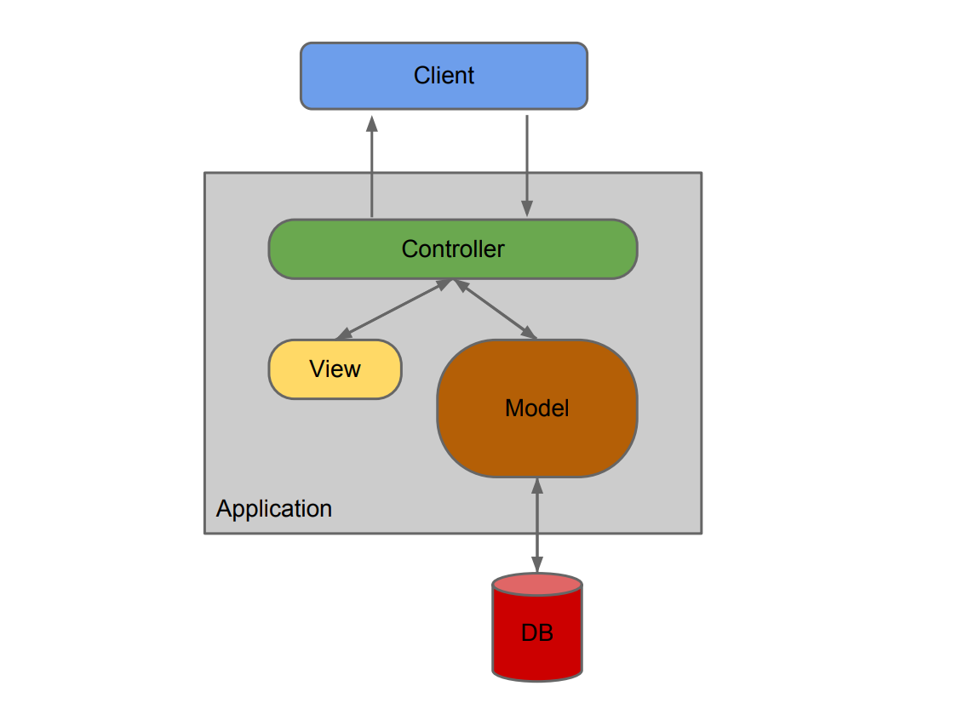
Model-View-Controller
Notes:
Let the model manage the data, the view display the data and the controller mediate updating the data and redrawing the display.

Slide 5

Model-View-Controller

Slide 6
Model-View-Controller
Code example

Slide 7
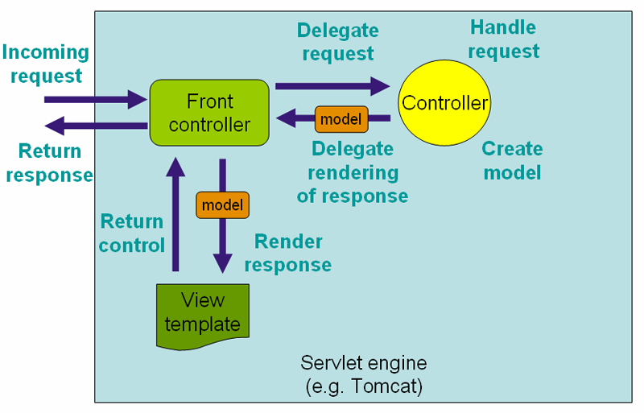
Spring MVC

Slide 8
Spring MVC. Configuration: web.xml
<web-app xmlns="http://xmlns.jcp.org/xml/ns/javaee" xmlns:xsi="http://www.w3.org/2001/XMLSchema-instance" xsi:schemaLocation="http://xmlns.jcp.org/xml/ns/javaee http://xmlns.jcp.org/xml/ns/javaee/web-app_3_1.xsd" version="3.1"> <display-name>Spring MVC Web Application</display-name> <servlet> <servlet-name>main</servlet-name> <servlet-class>org.springframework.web.servlet.DispatcherServlet</servlet-class> <load-on-startup>1</load-on-startup> <async-supported>true</async-supported> </servlet> <servlet-mapping> <servlet-name>main</servlet-name> <url-pattern>/</url-pattern> </servlet-mapping> </web-app>

Slide 9
Spring MVC. Configuration: servlet.xml
<?xml version="1.0" encoding="UTF-8"?> <beans xmlns="http://www.springframework.org/schema/beans" xmlns:xsi="http://www.w3.org/2001/XMLSchema-instance" xmlns:context="http://www.springframework.org/schema/context" xmlns:mvc="http://www.springframework.org/schema/mvc" xsi:schemaLocation="http://www.springframework.org/schema/beans http://www.springframework.org/schema/beans/spring-beans.xsd http://www.springframework.org/schema/context http://www.springframework.org/schema/context/spring-context.xsd http://www.springframework.org/schema/mvc http://www.springframework.org/schema/mvc/spring-mvc-4.0.xsd"> <context:annotation-config/> <context:component-scan base-package="org.geekhub.lesson16.springmvc"/> <bean id="basedViewResolver" class="org.springframework.web.servlet.view.InternalResourceViewResolver"> <property name="viewClass" value="org.springframework.web.servlet.view.JstlView"/> <property name="prefix" value="/WEB-INF/jsp/"/> <property name="suffix" value=".jsp"/> </bean> </beans>

Slide 10
Spring MVC. Controller
@Controller @RequestMapping(value = "/home") public class HomeController { @GetMapping(value = "string") public String byStringViewName() { return "home"; } @RequestMapping(value = "mav") public ModelAndView byModelAndView() { final ModelAndView mav = new ModelAndView("mav-view"); mav.addObject("serverDate", LocalDate.now()); return mav; } @RequestMapping(value = "in-mav", method = RequestMethod.GET) public ModelAndView byInputModelAndView(ModelAndView mav) { mav.setViewName("mav-view"); mav.addObject("serverDate", LocalDate.now()); return mav; } @RequestMapping(value = "in-model", method = {RequestMethod.GET, RequestMethod.POST}) public String byInputModel(Model model) { model.addAttribute("serverDate", LocalDate.now()); return "mav-view"; } @PostMapping(value = "rest") @ResponseBody public LocalDateTime restEndpoint() { return LocalDateTime.now(); } }

Slide 11
Spring MVC. Rest Controller
@RestController public class ExampleRestController { @GetMapping("rest") public List<String> rest() { return Arrays.asList("str1", "str2", "str3", "qwerty"); } @GetMapping("user-from-form") @ResponseStatus(HttpStatus.OK) public UserDto modelAttribute(@ModelAttribute UserDto user) { return user; } @GetMapping("username/{username}") @ResponseStatus(HttpStatus.INTERNAL_SERVER_ERROR) public String pathVariable(@PathVariable String username) { return username; } @GetMapping("username") public String requestParam(@RequestParam String username) { return username; } @PostMapping("user-from-body") public UserDto requestBody(@RequestBody UserDto user) { return user; } @GetMapping("put-to-session") public void toSession(@RequestParam String data, HttpServletRequest request) { request.getSession().setAttribute("data", data); } @GetMapping("get-from-session") public String fromSession(@SessionAttribute String data) { return data; } @GetMapping("redirect-me") public void redirect(HttpServletResponse response) throws IOException { response.sendRedirect("https://google.com"); } @RequestMapping(value = "exception") public String exception() { return "mav-view"; } }

Slide 12
Spring MVC. Controller: Detailed URL Mapping
@RequestMapping accepts the following parameters:
name
path (value)
method (GET/POST/PUT/DELETE...)
params
produces (mimeType)
consumes (mimeType)
Headers
Meta Annotations
@GetMapping
@PutMapping
@PostMapping
…

Slide 13
Spring MVC. Controller: URL Templates
@PathVariable - to map variables in URL paths
path variables can also be Regular Expressions
You can also do as follows
/message/user/{name}
@RequestParam – request.getParameter(“…”)
@SessionAttribute – request.getSession().getAttribute(“…”)

Slide 14
Spring MVC. Controller: @ModelAttribute
You can also use @ModelAttribute in controller to directly load URL value into the model
A Model can represent objects that can be retrieved from database or files as well
Model should not have logic, rather the controller should get the model and “transform” the model based on the request, while sending it to the View
Notes:
@ModelAttribute - request.getParameter(“…”) and set to dto

Slide 15
Spring MVC. View
Spring MVC integrates with many view technologies:
JSP
Velocity
Freemarker
Pebble
Values sent to controller with POST or GET as usual
Values made available to the view by the controller

Slide 16
Message Converters
Any data you return from REST endpoints should be converted to String
By default Spring you can return only String objects (StringHttpMessageConverter)
To extend this functionality Spring supports different message converters
You can implement you custom converter by implementing HttpMessageConverter or use one of predefined converters

Slide 17
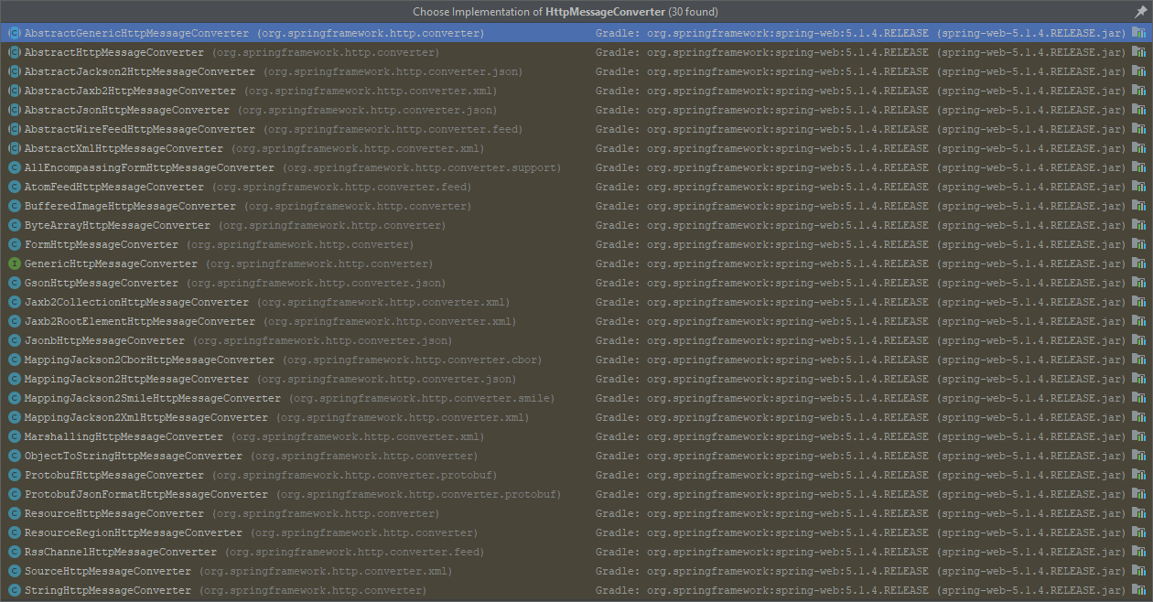
Message Converters. Predefined by Spring

Slide 18
Message Converters. XML Config
<?xml version="1.0" encoding="UTF-8"?> <beans xmlns="http://www.springframework.org/schema/beans" xmlns:xsi="http://www.w3.org/2001/XMLSchema-instance" xmlns:context="http://www.springframework.org/schema/context" xmlns:mvc="http://www.springframework.org/schema/mvc" xsi:schemaLocation="http://www.springframework.org/schema/beans http://www.springframework.org/schema/beans/spring-beans.xsd http://www.springframework.org/schema/context http://www.springframework.org/schema/context/spring-context.xsd http://www.springframework.org/schema/mvc http://www.springframework.org/schema/mvc/spring-mvc-4.0.xsd"> <context:annotation-config/> <context:component-scan base-package="org.geekhub.lesson16.springmvc"/> <mvc:annotation-driven> <mvc:message-converters> <bean class="org.springframework.http.converter.json.GsonHttpMessageConverter"/> </mvc:message-converters> </mvc:annotation-driven> <bean id="basedViewResolver" class="org.springframework.web.servlet.view.InternalResourceViewResolver"> <property name="viewClass" value="org.springframework.web.servlet.view.JstlView"/> <property name="prefix" value="/WEB-INF/jsp/"/> <property name="suffix" value=".jsp"/> </bean> </beans>

Slide 19
Message Converters. Java Config
Try to do it’s yourself

Slide 20
Interceptors
public class ControllerLogInterceptor extends HandlerInterceptorAdapter { private final Logger logger = Logger.getLogger(getClass().getSimpleName()); @Override public boolean preHandle(HttpServletRequest request, HttpServletResponse response, Object handler) { if (handler instanceof HandlerMethod) { logger.info("[" + LocalDateTime.now() + "]: [" + ((HandlerMethod) handler).getBeanType() + "] - START: " + request.getMethod() + " " + request.getRequestURI()); } return true; } @Override public void afterCompletion(HttpServletRequest request, HttpServletResponse response, Object handler, Exception ex) throws Exception { if (handler instanceof HandlerMethod) { if (ex != null) { logger.info("[" + LocalDateTime.now() + "]: [" + ((HandlerMethod) handler).getBeanType() + "] - ERROR: " + request.getMethod() + " " + request.getRequestURI() + ": " + ex.toString()); response.sendRedirect("error.html"); } else { logger.info("[" + LocalDateTime.now() + "]: [" + ((HandlerMethod) handler).getBeanType() + "] - COMPLETE: " + request.getMethod() + " " + request.getRequestURI()); } } } }

Slide 21
Interceptors. XML Config
<?xml version="1.0" encoding="UTF-8"?> <beans xmlns="http://www.springframework.org/schema/beans" xmlns:xsi="http://www.w3.org/2001/XMLSchema-instance" xmlns:context="http://www.springframework.org/schema/context" xmlns:mvc="http://www.springframework.org/schema/mvc" xsi:schemaLocation="http://www.springframework.org/schema/beans http://www.springframework.org/schema/beans/spring-beans.xsd http://www.springframework.org/schema/context http://www.springframework.org/schema/context/spring-context.xsd http://www.springframework.org/schema/mvc http://www.springframework.org/schema/mvc/spring-mvc-4.0.xsd"> <context:annotation-config/> <context:component-scan base-package="org.geekhub.lesson16.springmvc"/> <mvc:annotation-driven> <mvc:message-converters> <bean class="org.springframework.http.converter.json.GsonHttpMessageConverter"/> </mvc:message-converters> </mvc:annotation-driven> <mvc:interceptors> <bean id="logInterceptor" class="org.geekhub.lesson16.springmvc.ControllerLogInterceptor"/> </mvc:interceptors> <bean id="basedViewResolver" class="org.springframework.web.servlet.view.InternalResourceViewResolver"> <property name="viewClass" value="org.springframework.web.servlet.view.JstlView"/> <property name="prefix" value="/WEB-INF/jsp/"/> <property name="suffix" value=".jsp"/> </bean> </beans>

Slide 22
Interceptors. Java Config
Try to do it’s yourself

Slide 23
Controller Advice
@ControllerAdvice(assignableTypes = HomeController.class) public class HomeControllerExceptionHandler { @ResponseStatus(HttpStatus.INTERNAL_SERVER_ERROR) @ExceptionHandler({FileNotFoundException.class, RuntimeException.class}) public ModelAndView exceptionHandler(Exception ex) { ModelAndView mav = new ModelAndView("serviceException"); mav.addObject("errorMessage", "Some Message. " + ex.toString()); return mav; } }

Slide 24
Controller Advice
@ControllerAdvice(basePackages = "org.geekhub.lesson16.springmvc") public class GlobalExceptionHandler { @ResponseStatus(HttpStatus.INTERNAL_SERVER_ERROR) @ExceptionHandler(Exception.class) public ModelAndView exceptionHandler(Exception ex) { ModelAndView mav = new ModelAndView("serviceException"); mav.addObject("errorMessage", "Some Message. " + ex.toString()); return mav; } }

Slide 25
Literature
Spring - MVC Framework
Spring Tutorial
Spring Framework Documentation
Spring Web

Slide 26
Homework Task 1
Implement user management API protected with authentication by login and password using Spring MVC requirements
Add custom request logging interceptor using Java config. Interceptor should print:
Information about request start (including date, time, link, all request parameters, method that was used (GET, POST, PUT, etc))
Information about request end (including date, time, link, time was spend for request processing, method that was used (GET, POST, PUT, etc))
Information about exception if happened
Add custom ControllerAdvice for exceptions handling;
Add custom JSON message converter using Java config;
Add endpoints that return different dtos, list of dtos, etc to show that converter works;
Use your knowledge from previous tasks and review feedbacks

